Slide 1
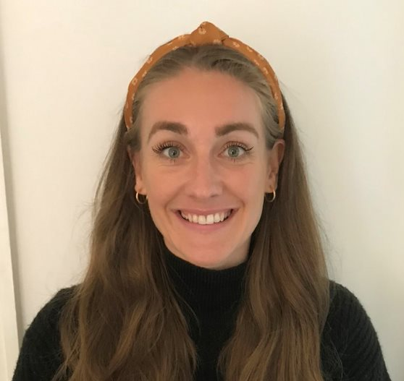
Pathway 3 Line Manager Briefing
Sophie Price
Programme Manager
@PathwaysSW
Pathways programme
Ruby Quinnell
Programme Officer
Notes:
Sophie

Slide 2
Today’s Session
Who is Frontline and what is the Pathways programme?
Who are the Pathway 3 leaders?
Pathways programme overview
Programme activity:
Residential
Coaching
Diagnostics
Experiential visits
Development goals
Expectations
Q&A
Notes:
Sophie

Slide 3
Frontline – who are we?
Frontline is a social work charity working to ensure
that all children in England have a safe and stable
home, and that their life chances are not limited by
their social or family circumstance.
Notes:
Ruby

Slide 4
The Social Work Leadership Pathways programme is a national practice leadership development programme for social workers.
The Pathways programme is delivered by Frontline in partnership with:
What Works for Children's Social Care
North Yorkshire County Council
In association with:
Hertfordshire County Council
Notes:
Ruby

Slide 5
Diversity and Inclusion
Specialised coaching matching where requested
Accessibility calls ahead of residentials
Pastoral support at residentials
Quiet room at residentials
Charter commitment by all leaders, facilitators, staff etc.
Incident response

Slide 6
Who are our Pathway 3 leaders?
95 Heads of Service & Service
Manager, aspirant team manager
73 local authorities
Mix of aspirant and in-role leaders
Notes:
Sophie

Slide 7
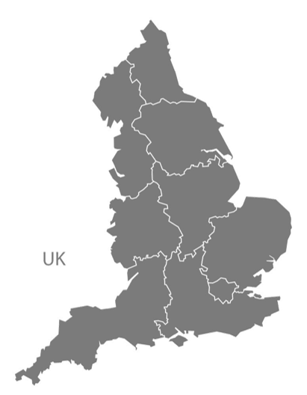
Meet the cohort (P3)
Achieving for Children
Barnet
Barnsley
Blackburn with Darwen
Blackpool
Bolton
Bracknell Forest
Bradford
Brent
Bristol
Buckinghamshire
Calderdale
Camden
Cheshire West and Chester
Coventry
Croydon
Darlington
Devon
Durham
Essex
Gateshead
Greenwich
Hackney
Hammersmith & Fulham
Haringey
Hartlepool
Hertfordshire
Hillingdon
Hull
Islington
Kirklees
Lambeth
Lancashire
Leeds
Leicestershire
Lewisham
Lincolnshire
Liverpool
Luton
Manchester
Merton
Middlesbrough
Newham
Northamptonshire
North Tyneside
North Yorkshire
Oldham
Oxfordshire
Peterborough
Redbridge
Rotherham
Rutland
Salford
Sandwell
Sefton
Sheffield
Somerset
Southwark
Staffordshire
Stockport
Stoke-on-Trent
Surrey
Swindon
Tower Hamlets
Waltham Forest
Wandsworth
Warrington
West Sussex
Wigan
Wirral
Wolverhampton
York
39
76
73

Slide 8
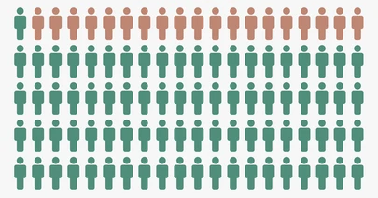
Age
Ethnicity
Other/prefer not to say 2%
Mixed 5%
Asian 7%
Black
12%
Gender
White 74%
Female – 76%
Male – 23%
vs.
workforce data
87% female
Aspirant (15)
In-role (83)
Notes:
​

Slide 9
Programme overview
Notes:
Ruby

Slide 10
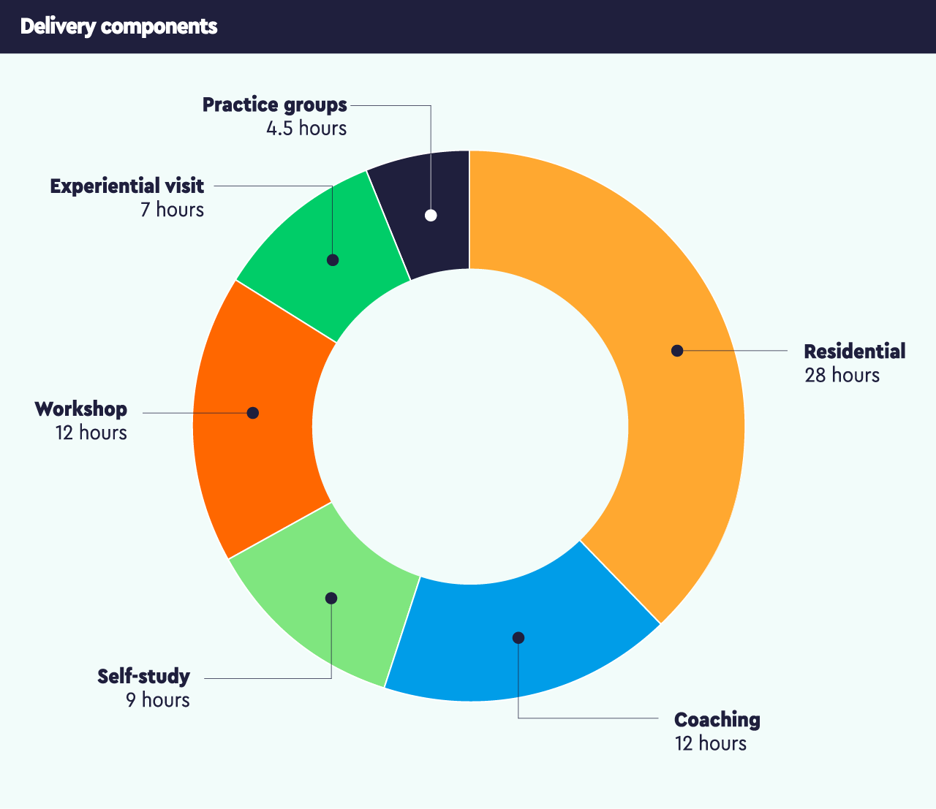
Programme overview
Notes:
Ruby

Slide 11
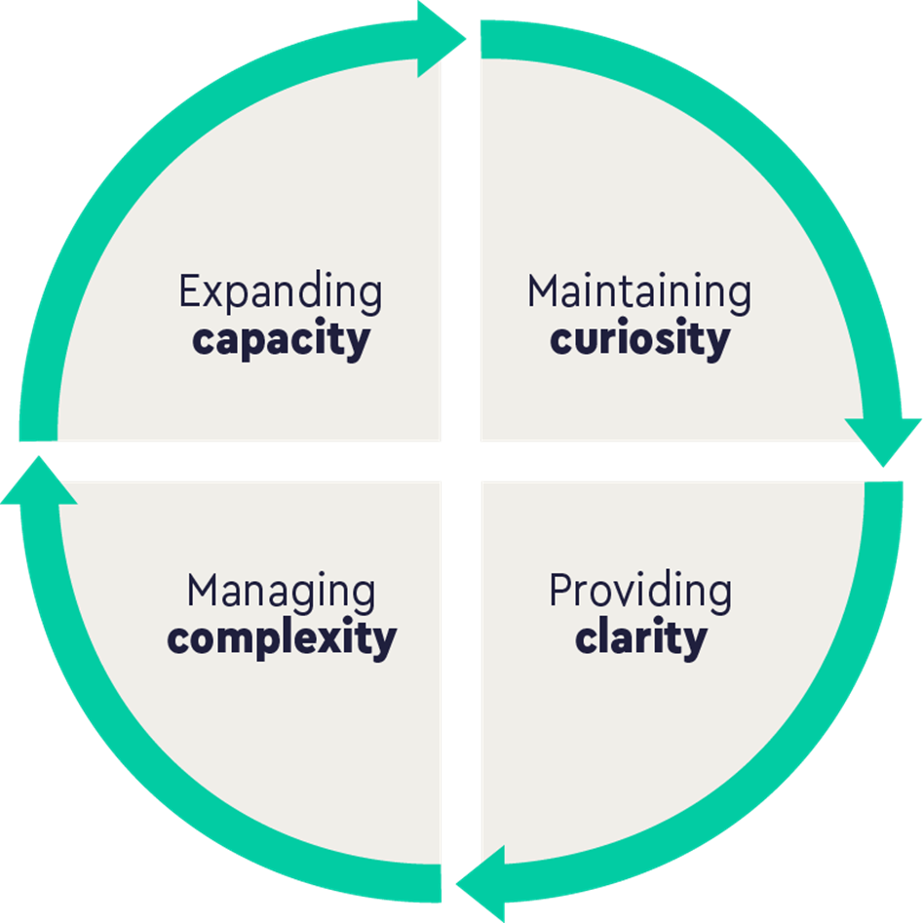
4Cs leadership capabilities
Notes:
Sophie

Slide 12
The Residential
Residential 1
When: 11-13 June 2023
Where: The University of Warwick, Coventry CV4 7AL
Residential 2
When: 29 April – 1 May 2024
Where: The University of Warwick, Coventry CV4 7AL
Notes:
Ruby (1 min)

Slide 13
June 2023
Pathway 3
Workshops
Workshop 1
Leading self-evaluations
What Works for Early Intervention and Children's Social Care
Workshop 2
Acting wisely in critical moments: A communication perspective
Dr Barbara McKay
Workshop 3
Managing Uncertainty in Practice
Alex Woods
Pathways programme
PathwaysSW
#PathwaysProgramme
Notes:
Ruby

Slide 14
June 2023
Pathway 3
Self-study modules
Leading self evaluations by What Works for Early Intervention and Children's Social Care
Acting wisely in critical moments: A communication perspective
Dr Barbara McKay
Surviving and thriving as a leader in children’s social care Rhian Taylor
Leading with Pride - Creating an Inclusive Workplace for LGBTQ+ People
Modelling Inclusive Leadership: an Organisational Perspective
Laura Clements and Harry Nutt
Leading Improvement at Scale Ann Domeney
Self-study 1
Self-study 2
Self-study 3
Self-study 4
Self-study 5
Self-study 6
Pathways programme
PathwaysSW
#PathwaysProgramme
Notes:
Ruby

Slide 15
Coaching
Leaders receive 6 coaching sessions to help them identify their areas for development and support them through their leadership journey on the programme.
Coaches receive a copy of the Leadership Diagnostics report to support the leaders.
- Missing coaching sessions
- Flagging this to leader/LA
Notes:
Sophie
1 min

Slide 16
Coaching Triads
The purpose of the triad is as follows:
At the start of the programme:
The initial coaching triad provides an opportunity for your direct report to share their reflections on this feedback and the development goals that they have identified relating to this.
Engaging with the initial coaching triad also enables you to identify ways of supporting your direct report in achieving their development goals during the programme (and beyond) and enhances your understanding of your direct report’s learning and development on the Pathway 3 programme.
At the end of the programme:
To reflect and review the impact of the programme and your direct reports development.
To consider next steps and ways that learning, and development can be supported by you (line manager) after programme ends.
To identify ways to broaden the impact your direct report can have across the service.

Slide 17
Experiential Visit
Logistics
Menu of options: Local Authorities and partner organisations
Immersive learning experience
Small groups
November 2023
1 day
Purpose of experiential visit
Learning from the field and from innovative practice in other local authorities and organisations providing services to children and families.
Expanding understanding of the national picture of social work.
Critically examining with peers how learnings can be applied in your own practice context.
Notes:
Sophie
1 min

Slide 18
Leadership
Diagnostics
The diagnostic will be completed by the leader and you as their line manager, peers and direct reports at the beginning and end of the programme
Beginning of Programme Diagnostic
End of Programme Diagnostic
The report is not directly shared with line managers.
Notes:
Sophie

Slide 19
Expectations
Attendance and engagement
Communication
Leader charter

Slide 20
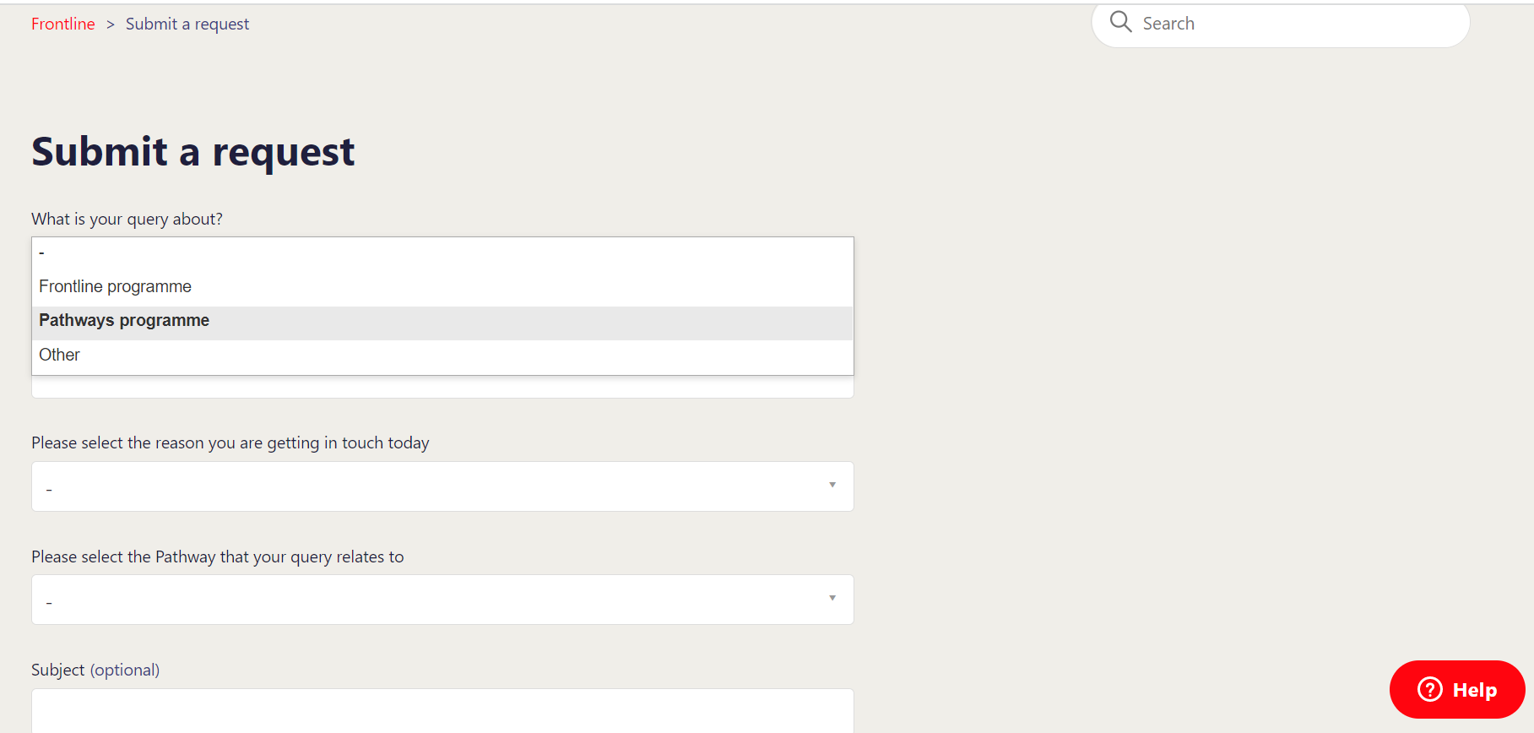
Online Helpdesk
For queries or issues either before or during the programme you would like to pass on to the team, please submit via our online helpdesk.
You can also access this via the ‘Contact us’ link in your welcome email.
Notes:
Sophie

Slide 21
How can you support your Leaders to get the most out of the programme?
Ensuring they have the protected time for the programme requirements
Enabling them to have the behaviours to maximise their learning from the programme opportunities
Working with them to identify opportunities to help them reach their development goals
Completing the leadership diagnostics
Contributing to the coaching triads

Slide 22
Questions
@PathwaysSW
Pathways programme
Notes:
Maria

